Slide 1
Progress Report: Auxiliary Components
By: Team 10

Slide 2
Brief Recap
Pre-trained KoELECTRA model as a base
Cross-validation method: K-Fold
57% accuracy

Slide 3
Progress Explored
Initial Flask setup
Music Dataset acquisition
Initial Music Recommendation System setup

Slide 4
Flask
Web application framework
Utilized EC2 & RDS Architecture
Main logic/codebase completed
Issues implementing model

Slide 5
Flask Codebase
Obtain the user's name, phone number, and current mood.
Based on the mood text, send a query to the RDS (Relational Database Service) to retrieve a list of songs with the same label as the analyzed main emotion.
Using cosine similarity, compare the softmax probabilities of the song list and the user's sentiment analysis text to recommend the song with the highest score.
Record whether the user is satisfied with the recommended song (to be used as a future performance metric).

Slide 6
Music Dataset
Utilized web crawler to gather the dataset
Based on music in specific Melon Playlists
640 songs
Initial Dataset structured as [ title / lyrics / label ]
Specifically purposed for recommendations and not as additional training data

Slide 7
Music Recommendation
Exclude lyrics that contain English words not present in trained data
4 lines of lyrics = 1 sentence
Model calculates the probability value on a per sentence basis
Average of all sentences = average probability values for 1 song

Slide 8
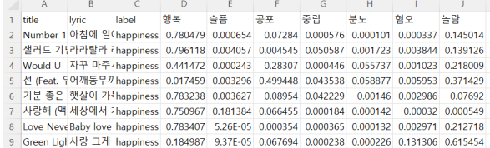
Music Recommendation cont.
Results saved into new csv file

Slide 9
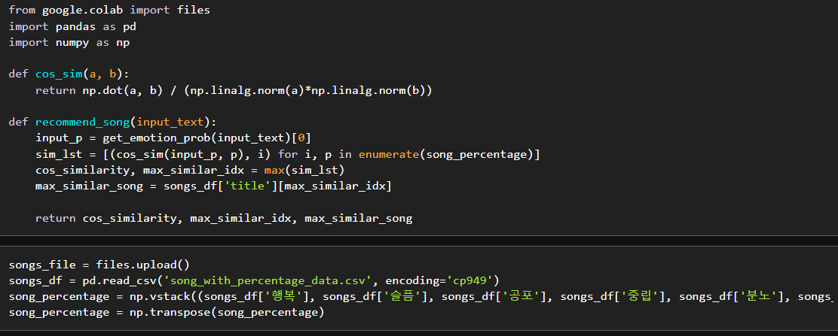
Music Recommendation cont.
Compares the probability values of inputted text & songs

Slide 10
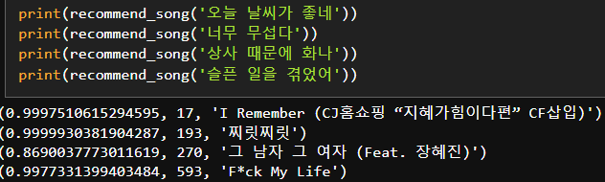
Music Recommendation Results
Title | label | 행복 | 슬픔 | 공포 | 중립 | 분노 | 혐오 | 놀람
I remember | happiness | 0.032051159 | 3.62E-05 | 0.000411675 | 0.002636646 | 0.000195786 | 0.001188108 | 0.963480383
찌릿찌릿 | happiness | 0.000379623 | 0.000187953 | 0.994581513 | 4.51E-05 | 0.00012661 | 0.000750174 | 0.003929036
그 남자 그 여자 | sadness | 0.252839005 | 0.087859564 | 0.003019698 | 0.00051942 | 0.520144199 | 0.128552195 | 0.007065943
F*ck my life | anger | 0.034854969 | 0.893035608 | 0.004912716 | 0.0459447 | 0.001760734 | 0.003019449 | 0.016471821

Slide 11
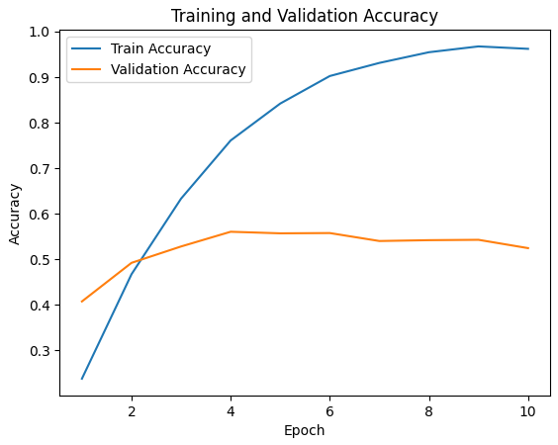
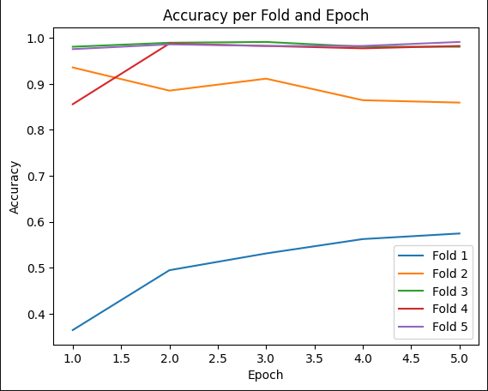
Model Results?
No changes to the model presented last week

Slide 12
Future Endeavors
Finish up model & Fine-tuning
Complete setup of model on Flask
Manual verification of the music recommendation system

